Slide 1

POR Board of Trustees Presentation of the
July 1, 2025 Actuarial Valuation Results
Presented
October 20, 2025
Patrice Beckham, FSA, EA, FCA, MAAA
Aaron Chochon, ASA, EA, FCA, MAAA

Slide 2



Purpose of an Actuarial Valuation
Performed Annually as of July 1
Funding Results
Projection Results
Update previous valuation and reflect fiscal year 2025 events
Comment on, and quantify, fiscal year 2025 events that impacted the July 1, 2025 valuation
Assess and disclose key funding risks
Disclose key asset and liabilities measures
Funded ratio and Unfunded Actuarial Accrued Liability (UAAL) as of July 1, 2025
Determine Actuarial Contribution Rate for FY 2026
Evaluate the sufficiency of the current statutory funding of the System including additional $5 million.
Using modeling tool, project System’s funded status in the future, if all assumptions are met.
Sensitivity analysis on projection results if investment returns vary from the assumed rate of return.

Slide 3
Experience impacting the July 1, 2025 valuation
Liability Experience
Other Experience
Asset Experience
Net market return for fiscal year 2025 of 10.4%.
Due to asset smoothing, return on actuarial assets was 6.9%, primarily due to the FY 2022 investment experience.
Resulted in an actuarial gain of $3.2 million.
Both actuarial gains and losses on liabilities occurred in fiscal year 2025.
Main sources of loss were mortality and salary experience that were less favorable than expected, based on the assumptions.
Net liability loss of $1.6 million.
House File 969 broadened the cancer coverage for accidental disability.
Member contribution rate increased 0.125% of payroll to offset the potential cost.
Contribution shortfall for FY 2025 increased the UAAL by $6.7 million.

Slide 4
Actuarial Reserve Funding
Builds funds during working careers.
Investment returns help pay for benefits.
Actuarial valuation is mathematical model of financial future of system.
Actuarial cost method’s goal is level contributions as percent of payroll.
Goal is contribution equity among generations of active members and taxpayers.

Slide 5

The Actuarial Model
Inputs
  Membership Data
  Benefit Provisions
  Asset Data
  Actuarial Assumptions
  Actuarial Methods
Actuarial Model
  Employer Contribution
  Unfunded Actuarial Liability (UAL)
  Funded Ratio
  Actuarial Gain or Loss
  Projections
Results

Slide 6

Membership Data
 | July 1 Valuation
 | 2025 | 2024 | 2023 | 2022 | 2021 | 2020
Active Members
Count | 577 | 583 | 588 | 555 | 547 | 555
Average Age | 40.8 | 41.1 | 41.1 | 41.6 | 42.1 | 42.4
Credited Service | 15.4 | 15.6 | 15.7 | 16.2 | 16.8 | 17.0
Annual Salary | $104,734 | $101,090 | $95,390 | $91,176 | $89,779 | $87,302
Retired Members
Count | 700 | 687 | 679 | 673 | 654 | 635
Average Age | 71.1 | 71.0 | 71.2 | 70.9 | 71.1 | 71.7
Annual Benefit | $65,113 | $62,559 | $59,472 | $57,541 | $55,847 | $54,584
Inactive Vested
Count | 43 | 44 | 44 | 42 | 41 | 42

Slide 7
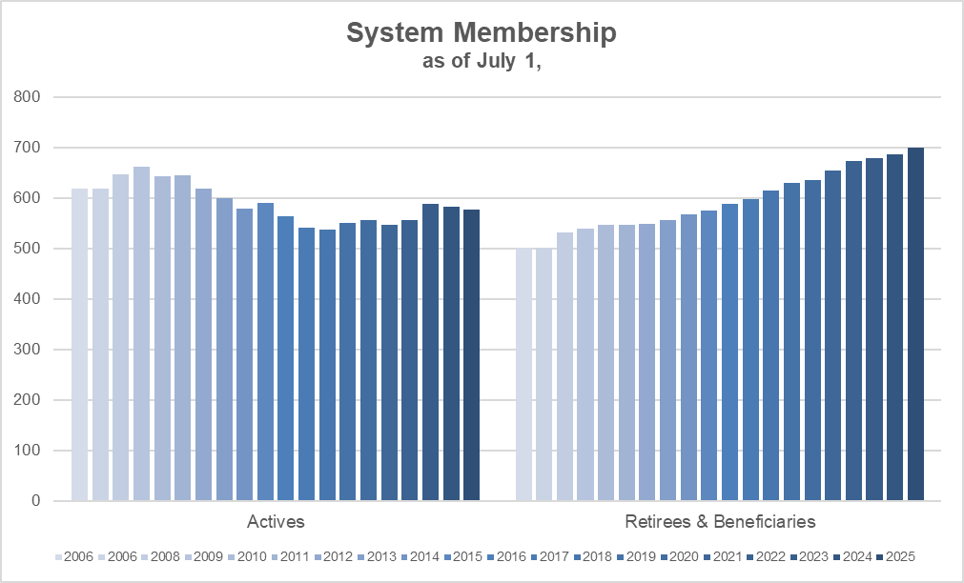
Longer Term Historical Membership Data
The active count has declined by 13% from its peak in 2009 while the number of members receiving a benefit has steadily increased. With fixed contribution rates, the decrease in the active population creates pressure on the funding of the System because covered payroll, and therefore contributions, are lower.

Slide 8
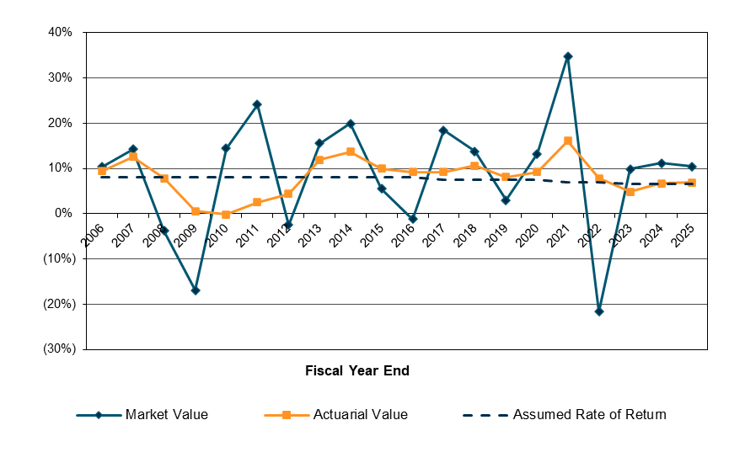
Historical Asset Returns
With actuarial funding, assets are accumulated while members are actively working to fund the
future benefit payments in advance. Given the extreme volatility in the market value returns,
an asset valuation method is used to smooth the returns.

Slide 9

Change in Asset Values ($M)
Market Actuarial
7/1/24 Value $749.1 $768.4
  Contributions 33.9 33.9
  Benefit Payments (43.2) (43.2)
  Admin Expenses (0.3) (0.3)
  Net Investment Return 78.2 52.8
7/1/25 Value $817.7 $811.7
Rate of Return +10.4% +6.9%
Note: numbers may not add due to rounding
The 6.9% return on the actuarial value of assets was greater than the assumed rate
of 6.5% which created an actuarial gain of $3.2 million.

Slide 10
Actuarial Value of Assets
Asset Smoothing Method - how and when actuarial asset gains/losses are recognized
  Smoothing is based on difference between actual and expected return on market value of assets
  Smoothing period is 5 years
  Net deferred gain yet to be recognized is $6.1 million as shown below compared to net deferred loss of $19.3 million last year.
$
$
$
$
FY Ending: 2025 2024 2023 2022
Millions $: 23.8 19.6 8.6 (46.0)

Slide 11
Recognition of Deferred Asset Experience
 | Gain/(Loss)
Plan Year | Deferred to | Gain/(Loss) to be Recognized in Plan Year Ending
Ended | Future Years | 2026 | 2024 | 2027 | 2025 | 2028 | 2026 | 2029
6/30/2022 | (46,017,273) | (46,017,273)
6/30/2023 | 8,644,971 | 4,322,486 |  | 4,322,485
6/30/2024 | 19,609,089 | 6,536,363 |  | 6,536,363 |  | 6,536,363
6/30/2025 | 23,816,274 | 5,954,069 |  | 5,954,069 |  | 5,954,069 |  | 5,954,067
Total | $6,053,061 | ($29,204,355) |  | $16,812,917 |  | $12,490,432 |  | $5,954,067
Note: the net deferred experience of $6.1M is not recognized equally over the next four years, but rather each year’s experience is on its own schedule of five-year recognition. Future experience will also impact the net amount of gain/loss recognized in future years.

Slide 12
Actuarial Accrued Liability (AAL)
In-pay liability of $627M is
61% of total actuarial accrued
liability.
Actuarial Accrued Liability: $1,031M
Actuarial Assets: 812M
Unfunded Liability: $ 220M
Funded Ratio: 79%

Slide 13

Unfunded Actuarial Accrued Liability (UAAL)
UAAL July 1, 2024 $220.6
Expected decrease from amortization (5.2)
Contributions below actuarial rate 6.7
Investment experience (3.2)
Liability experience* 1.6
Other experience (0.8)
UAAL July 1, 2025 $219.7
*Primarily due to mortality and salary experience that were less favorable than expected, based on actuarial assumptions.

Slide 14
Actuarial Contribution Rate
Components:
    Normal Cost
    Administrative Expenses
    Amortization of UAAL
“Layered amortization” method is used:
    Legacy UAAL amortized over 30 Years from 2008 (Closed Period) so 13 years remain as of July 1, 2025
    New pieces of UAAL amortized over closed 20-year periods
    UAAL payment is the sum of the payments for all bases
Utilization:
  Only a benchmark to evaluate the adequacy of the current contribution rates
  Projections are necessary to evaluate the Plan’s long-term funding

Slide 15
UAAL Contribution Rate

Slide 16
Normal Cost Rate
 | July 1, 2025 Valuation | July 1, 2024 Valuation
Retirement Benefits | 28.702% | 28.710%
Withdrawal Benefits | 0.680% | 0.680%
Death Benefits | 0.739% | 0.740%
Disability Benefits | 5.200% | 5.200%
Total | 35.321% | 35.330%
The normal cost rate usually remains stable, absent changes to the actuarial assumptions.

Slide 17
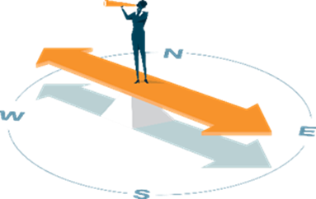
Actuarial Contribution Rate
Normal Cost 35.321%
Administrative Expenses 0.521%
UAAL Contribution * 32.704%
Total Actuarial Contribution Rate 68.546%
* Amortization of UAAL payments are as a level percent of payroll, assuming a 2.75% annual increase in payroll so the dollar amount of payments increase in the future.

Slide 18
Change in Actuarial Contribution Rate
Actuarial Contribution Rate 7/1/24 68.070%
Change due to:
  Asset experience (0.373%)
  Liability/other experience (0.002%)
  Payroll increased less than expected 0.068%
  Change in normal cost rate (0.009%)
  Contributions less than actuarial rate 0.792%
Actuarial Contribution Rate 7/1/25 68.546%
In our professional judgement, the actuarial contribution rate developed here is “reasonable”
as defined in Actuarial Standard of Practice Number 4.

Slide 19
Contribution Rate Analysis
 | 7/1/2025 | 7/1/2024
Total Actuarial Contribution Rate | 68.546% | 68.070%
Member Contribution Rate | (11.525%) | (11.400%)
State Actuarial Contribution Rate | 57.021% | 56.670%
Statutory State Contribution Rate | (37.000%) | (37.000%)
State Supplemental Contribution* | (8.274%) | (8.480%)
Contribution Shortfall/(Margin) | 11.747% | 11.190%
Expected Payroll ($M) | $60.4 | $58.9
Estimated Shortfall/(Margin) ($M) | $7.1 | $6.6
* $5.0 million per year for both FYE 2025 and FY 2026.

Slide 20
Historical Contribution Rates
Over the early part of this period, the statutory rate was significantly below the actuarial rate. With legislative changes, the statutory contribution rate has been close to or greater than the actuarial rate between fiscal year 2014 and fiscal year 2022. However, there have been contribution shortfalls in the past four valuations.

Slide 21
Projected Funded Status: 2024 vs 2025 Modeling
The actual return for FY 2025 had a positive impact on the projected results (compare the orange and blue lines). However, the funded ratio remains around 75% to 85% for 9 years.
Projections assume all actuarial assumptions are met each year in the future and all contributions are made as scheduled, including the $5 million supplemental contributions until the System is 85% funded.

Slide 22
Analysis of Investment Risk
Years of additional $5 million State contribution given various FY 2026 returns. Returns in FY 2027 and beyond are assumed to be 6.5% for purposes of this analysis.
FY 2026 Rate of Return | Years of Additional $5M
10.0% | 5 years
6.5% | 10 years
3.0% | 17 years
0.0% | 28 years
Assumes that all actuarial assumptions are met in the future and current statutory funding remains unchanged.

Slide 23
Summary Comments
Contribution shortfall for FY 2026 of 11.747%
  Return of +6.9% on actuarial value of assets resulted in a $3.2M gain.
  Partially offset by liability loss of $1.6M
  State supplemental contribution of $5M is expected in foreseeable future.
Long-term financial health of the System is dependent on future investment returns and scheduled contributions, including the $5 million supplemental payment
  The funded ratio is projected to remain between 75% and 85% over the next 9 years if all assumptions are met. Actual experience will impact these projections from year to year, perhaps significantly.
  Recommend closely monitoring the contribution shortfall and projected funded status trend each year in order to evaluate whether changes in the current funding policy are needed to address the long-term funding of the System.

Slide 24

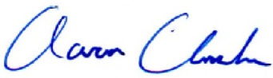
Actuarial Certification
We, Patrice Beckham, FSA, and Aaron Chochon, ASA are consulting actuaries with Cavanaugh Macdonald Consulting, LLC. We are members of the American Academy of Actuaries and the Society of Actuaries and meet the Qualification Standards of the American Academy of Actuaries to render the actuarial opinions contained herein. We are available to answer any questions or provide additional information as needed.
Patrice A. Beckham, FSA, EA, FCA, MAAA
Consulting Actuary
Aaron J. Chochon, ASA, EA, FCA, MAAA
Senior Actuary

Slide 25

THANK YOU

